Slide 1
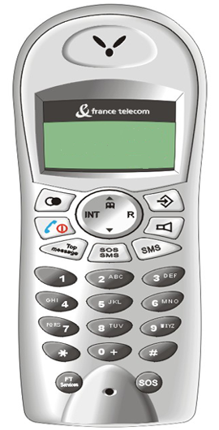
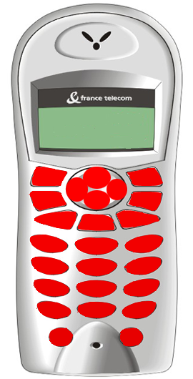
How to detect which key be pressed ?
Image1 is HS.bmp, Image3 is HS_red.bmp, and their size is 270*530. They begin from (0,0). Image1 is visible and Image3 is invisible, depicted as bellow.
The color of each pixel is a triple value, (R, G, B)
Color is (255, 0, 0)
Color is (254, 0, 0)
Color is (253, 0, 0)
⋮
Color is (251, 0, 0)
The color of each key is different.
Image1(HS.bmp)
Image3(HS_red.bmp)

Slide 2
How to detect which key be pressed ? (continue)
When user press mouse, Image1MouseDown(TObject *Sender, TMouseButton Button, TShiftState Shift, int X, int Y) function be triggered. And we can know which key be pressed by the color of pixel[X][Y]. Eg. We know KEY_UP is pressed when the color of Image3->Picture->Bitmap->Canvas->Pixels[X][Y] is (255, 0, 0). Ref. KeyPad::WhichKeyPressed(), KeyPad::KeyPad()
KEY_UP
Image1(HS.bmp)
Image3(HS_red.bmp)

Slide 3

How to display the key be pressed ?
After we detect KEY_UP be pressed, we load key_up.bmp to Image2 and display Image2 over the Image1. (The real view is no white around the key_up.bmp because we set Image2->Transparent = true.)
Ref. Key::ShowKeyPressed()
Image2(key_up.bmp)
Image2(key_up.bmp)
Image1(HS.bmp)
The view after key_up be pressed

